Slide 1
The Power of Rhetoric
Week 33 English 2B

Slide 2
GIVE
ME
POWER!

Slide 3
Real power resides
not in those who earn money . . .
But in those who convince others
to earn money for them.

Slide 4
Real power resides
not in those who buy things . . .
But in those who convince others to buy them

Slide 5
Real power resides
not in those who hate . . .
But in those who convince others to hate.

Slide 6
Real power resides
not in those who love . . .
But in those who convince others to love .

Slide 7
Real power resides
not in those who
fight . . .
But in those who make
others glad to fight .

Slide 8
Real power
resides not
in those who
believe . . .
But in those who convince others to believe.

Slide 9
The power to act
resides with us . . .
But the power to move others to act depends on our power over language.

Slide 10
And the power of language is . . .
Rhetoric
Rhetoric
Rhetoric
Rhetoric
Rhetoric

Slide 11
Powerful Voices: Study in Rhetoric
You now know how to organize your thoughts and you know it’s important to produce specific evidence to support your assertions and to thoroughly explain your evidence.
Now we will work on methods you can use to give your arguments more emphasis and strength.

Slide 12
Rhetoric is the counterpart of Dialectic. Both alike are concerned with such things as come, more or less, within the general ken of all men and belong to no definite science. Accordingly all men make use, more or less, of both; for to a certain extent all men attempt to discuss statements and to maintain them, to defend themselves and to attack others.
Ordinary people do this either at random or through practice and from acquired habit. Both ways being possible, the subject can plainly be handled systematically, for it is possible to inquire the reason why some speakers succeed through practice and others spontaneously; and every one will at once agree that such an inquiry is the function of an art.
- Aristotle, in his introduction to Rhetoric, written circa 350 BCE

Slide 13
Rhetoric:
The art of speaking or writing effectively.
Aristotle says rhetoric is "the ability, in each particular case, to see the available means of persuasion."
He described three main rhetorical strategies:
  Ethos – Speaker Perceived credibility or reputation of the speaker. Level of respect and honor given to the speaker by the audience.
  Pathos – Audience. Appeals to the audience’s emotions.
  Logos – Words. An appeal to logic. A demonstration of proof.

Slide 14
Logos
Pathos
Ethos

Slide 15
Modes of Argument
The mode of an argument is the way in which the argument is presented. It is its organizational pattern. Some arguments use several modes, just as they do blends of rhetorical strategies.

Slide 16
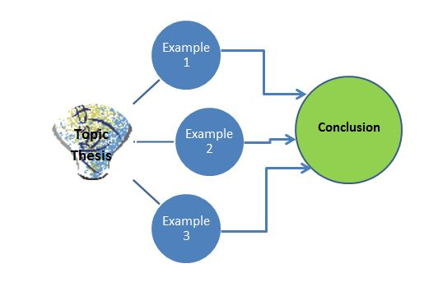
A Few Basic Modes of Argument
Exemplification – Provides specific examples to support the assertion (examples directly connected to the subject. High fat foods: fries, Twinkies, deep fried Twinkies . . .)

Slide 17

A Few Basic Modes of Argument
Enumeration – Organizes by listing categories or details (There are three basic principles that govern . . . )
2
3
1

Slide 18
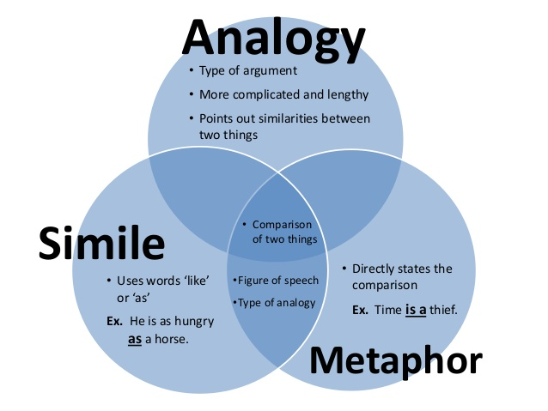
A Few Basic Modes of Argument
Analogy – making direct comparisons between the subject and similar circumstances (Just like in the 1920s, when liquor was illegal under Prohibition . . .)

Slide 19
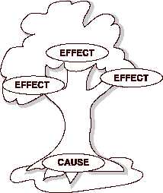
A Few Basic Modes of Argument
Cause to Effect – Presents the source that led to the problem (The banks lent to unworthy borrowers . . . The mortgage market collapsed)

Slide 20
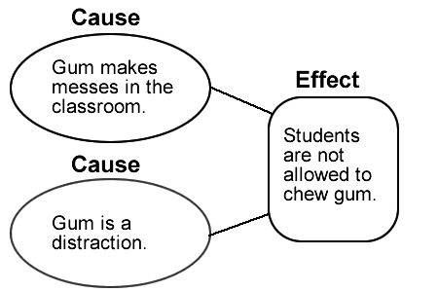
A Few Basic Modes of Argument
Effect to Cause – Presents the problem and then what caused it (The mortgage market collapsed . . . this was directly connected to the banks lending to unworthy borrowers)

Slide 21

A Few Basic Modes of Argument
Process – Organized in step-by-step order (A few banks developed complex loan instruments . . . They began pushing these on consumers . . . They packaged them as mortgage-backed securities to investors . . . High-risk loans ballooned . . . High-risk loans began to default in large numbers . . . Mortgage-backed securities collapsed in value . . . Major corporations went bankrupt.)

