Slide 1
Week 15
English 2 2017 Cook

Slide 2
13 November 2017 Eng 2
“The mask was a thing of its own,
behind which Jack had liberated from shame and self-consciousness (64).”
Analysis: What small semblance (glimmer) of civility Jack had has been obliterated (wiped out) by his hunting mask.
Why does Jack need the mask? What do we hide behind? Why do we avoid shame and self-consciousness?

Slide 3
Unit 4 BIG question:
How does society influence and shape the individual?

Slide 4
Unit 4 Task 8
10 Nonfiction Articles
Read and interact with (annotations, highlight, circle, underline)
Analyze THREE
Use the Nonfiction format (page 2)
Due 16 November Thursday

Slide 5
Unit 4 Task 9
Chapters 1-12 Vocabulary & Activities
Part 1 –Week 14 Chapters 1-4
Part 2 –Week 15 Chapters 5-8
Part 3 –Week 16 Chapters 9-12
Write answers on own paper
OR NEATLY in packet
All due 4 December 2017 Monday

Slide 6
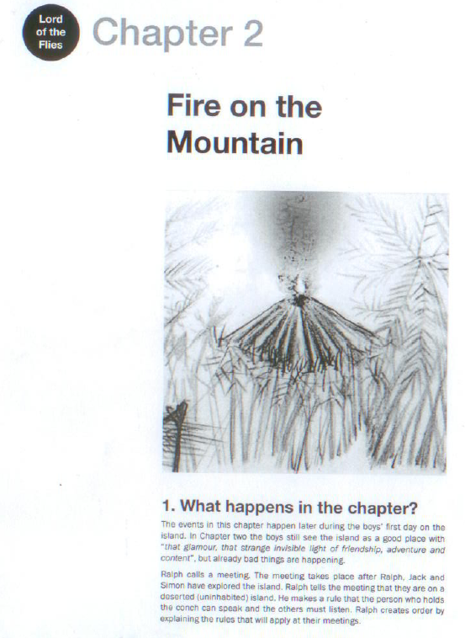
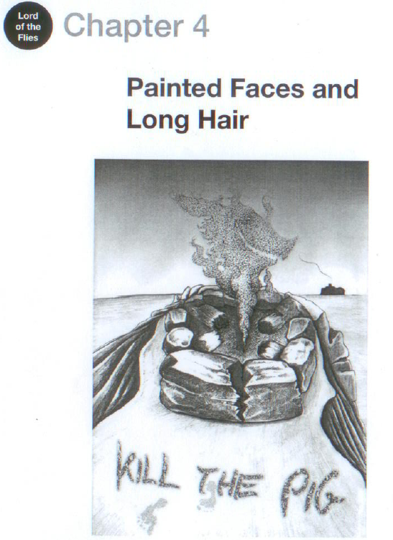
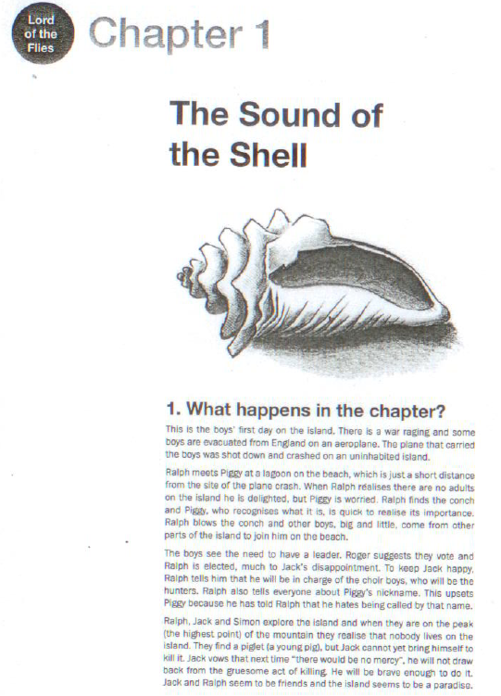
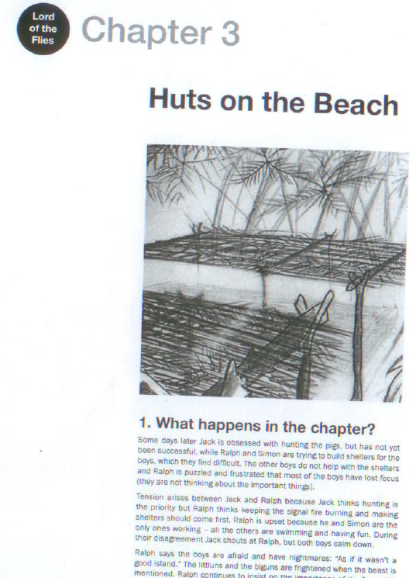
Chapter Information

Slide 7
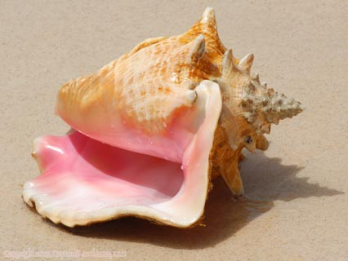
Chapter 1
The Sound of the Shell p 7
5 key ideas:
Remote jungle setting
all British schoolboys
Ralph found a conch shell
Boys select Ralph as leader
Older boys explore and find the island has good qualities

Slide 8
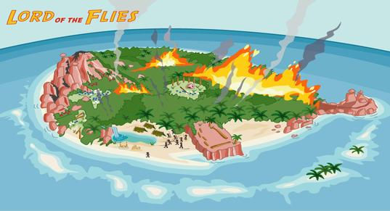
Chapter 2
Fire on the Mountain p 32
5 key ideas:
Next meeting that afternoon
Rule #1: Conch Shell must be held to speak
Littl’un asks about beastie
Ralph says they need a signal fire on the mountain
The boys set the mountain on fire (may have killed litt’uns)

Slide 9
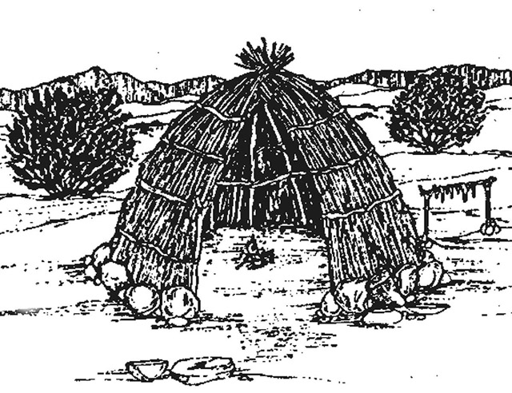
Chapter 3
Huts on the Beach p 48
5 key ideas:
Days later, Jack still unsuccessful at hunting
No shelters are built, etc.
Nightmares are happening
Jack & Ralph clash
Simon is helpful to all and comfortable in the jungle
(others are afraid, having nightmares)

Slide 10
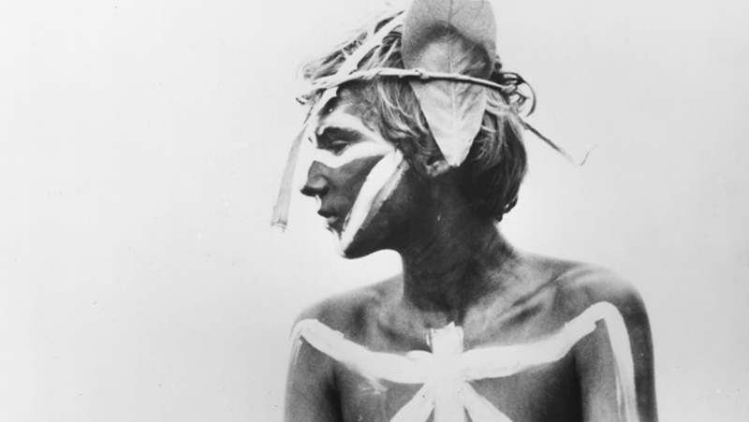
Chapter 4
Painted Faces & Long Hair p 58
5 key ideas:
It has been a while…
Ralph spots a ship but the fire is out
The hunters have their first kill- but their job was the fire! Ralph is ticked at Jack
Jack lashes out at Piggy and breaks his glasses
They dance and eat roasted meat

Slide 11
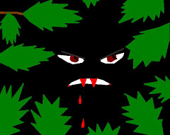
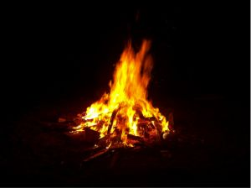
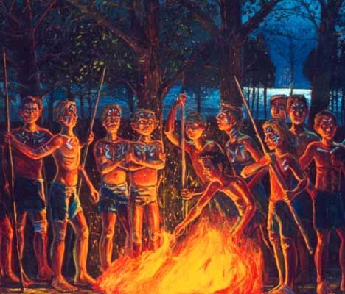
Group Poster
5 symbols (so far):
Create a visually pleasing
graphic representation of these 5 symbols in Lord of the Flies
Label the symbol
Explain what it stands for
in each chapter it is featured
Each group member should be responsible for one symbol
You may use any resources you have available

Slide 12
Group Poster
5 symbols (so far):
Create a visually pleasing
graphic representation of these 5 symbols in Lord of the Flies
Label the symbol
Explain what it stands for
in each chapter it is featured
Each group member should be responsible for one symbol
You may use any resources you have available
Go to Google Class and answer the Question for +10 pts

Slide 13
15 November 2017
You are “finished” when:
Symbol poster turned in
2. Google Question answered
3. Unit 4 TASK 8 –three articles are analyzed
4. Read Chapters 1-6 of Lord of the Flies for success on Friday’s Quiz #7
5. Unit 4 TASK 9 Part 1 Chapters 1-4 &
Unit 4 TASK 9 Part 2 Chapters 5-8

Slide 14
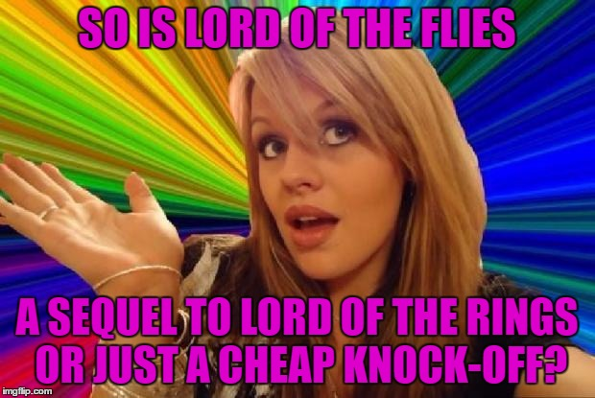
16 November 2017
Week 15 LOTF Focus Notes
EQ: How does society influence and shape the individual?

Slide 15
Chapter | What happens | Themes | Symbol
The Sound of the Shell | The boys’ first day on the island… The boys are stranded on the island after a plane crash Ralph and Piggy find a conch Ralph is elected leader | Innocence; Order and disorder; Leadership; Civilization and savagery; Good and evil | The conch The scar

Slide 16
Chapter | What happens | Themes | Symbol
2. Fire on the Mountain | Later that day… The boys light a fire to attract a ship The forest catches fire A littlun disappears | Order and disorder; Leadership; Fear | The conch Piggy’s glasses Fire

Slide 17
Chapter | What happens | Themes | Symbol
3. Huts on the Beach | Some days later… Ralph thinks that having the signal fire and building shelters is important Jack thinks that hunting is more important The boys are frightened | Civilization and savagery; Power; Fear; Good and evil | Fire The beast (nightmares)

Slide 18
Chapter | What happens | Themes | Symbol
4. Painted Faces & Long Hair | More days later – (the day that the ship passed by) Ralph sees a ship passing but the fire has gone out Jack has killed a pig, which they roast The boys have painted their faces. They dance, chanting: “Kill the pig…” | Innocence and corruption; Good and evil; Civilization and savagery; Leadership | Fire Piggy’s glasses The pig hunt

Slide 19
Chapter | What happens | Themes | Symbol
Beast from Water | The evening of the day that the ship passed by… Ralph calls an assembly to put things right. He says the signal fire must be kept alight The meeting end in chaos | Order and disorder; Loss of innocence; Power; Leadership; Fear; Wisdom | The conch The beast

Slide 20
6.Beast from Air | Later that night and the next morning… A dead man wearing a parachute lands on the mountain. The wind makes him move as if he is alive. Samneric think it is the beast. They tell the others. | Fear; Power; Order and disorder; Civilization and savagery; Wisdom; Good and evil | The conch Fire The beast

